Slide 1

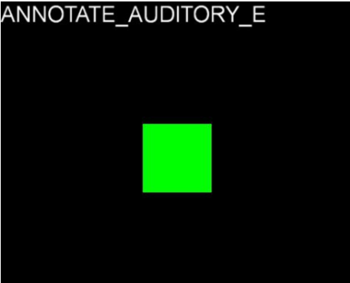
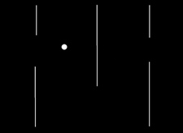
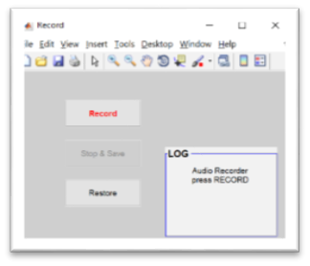
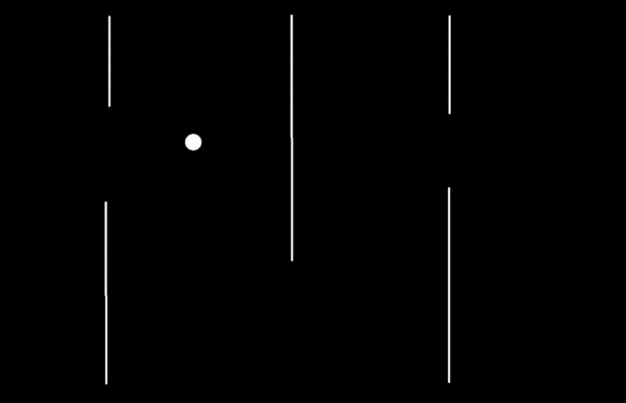
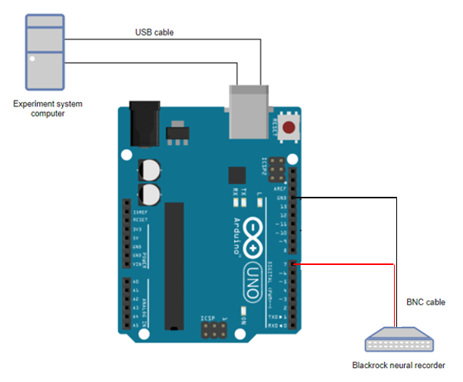

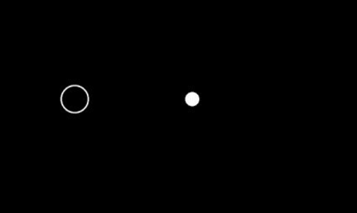

An experiment system interfacing equipment for recording electrical activity of single neurons in the human brain
Project Number: 16-1-1-1112
By: Tal Marziano, Omer Shamia Advisor: Dr. Ariel Tankus
Project Carried Out at Ichilov Hospital
Our Goals
Help to improve Ariel Tankus’ experiment paradigm:
Create a fast and reliable synchronization system between an experiment software to a neural activity recorder connected to depth brain electrodes.
Reprogram current code and derive new code using Matlab and unique toolbox to create a more advanced software with new abilities and achieve enhanced performances.
Experiment System
Matlab based program, easy to modulate and understand, in use of neural activity experiments which includes:
Event logs of mouse movement, time and tasks.
Auditorial and Visual stimuli for impaired hearing or eyesight patients.
Ability to connect to a decoder which translates neural activity to cursor movement.
Various “play modes” to stimulate different parts of the brain.
Audio Recorder Software
Synchronization
Visual Stimuli
Labyrinth mode
Audio Recorder
Created a synchronization system which uses an Arduino to bridge between one system to another.
The time delay between the two systems is less than 1msec in order to maintain reliable and accurate time logs.
Time logs are sent at different time intervals so it is possible to match between the two logs even when a log is lost.
“Center-Out” – following a moving target on the screen

